Slide 1
INK OF PROGRESS
Navigating Literacy rates’s impact on Indian “BIMARU” states socio-economic dynamics.
Prakhar Shankar
234161007
16/11/2023

Slide 2
agenda
Motivation 3
Block Diagram 4
Pseudo Code View 5
Snap Shots and Results 6
Observation 12

Slide 3

Motivation
Wisdom from grandparents : Emphasis on education as the key to empowerment.
Fascination with Magadha : Once a hub of knowledge and intellectual prowess.
Modern Bihar’s struggles : A shift from historical eminence to contemporary challenges.
Question the role of literacy : Exploring the connection between literacy rates and socio economic status.
A personal quest : How Bihar’s literacy rates may influence its current socio-economic dynamics.

Slide 4
BLOCK DIAGRAM
Define the Socio Economic parameters
Finally write my observations
Select the model states
Population growth , Sext ratio , fertility rate , etc
Study the trends in data
Take the help of the govt websites to collect data
Plot the data with python
Clean the data

Slide 5
Pseudocode
# Function to create a DataFrame from a CSV file
function create_dataFrame(file_path):
return DataFrame from CSV file at file_path
# Function to clean literacy data
function clean_literacy_data(dataFrame_literacy):
for each decade in dataFrame_literacy:
Replace empty and '-' values with NaN
Convert values to float
# Function to clean population data
function clean_population_data(dataFrame_population):
for each decade in dataFrame_population:
Replace empty and '-' values with NaN
Convert values to float
# Function to clean sex ratio data
function clean_sex_ratio_data(dataFrame_sex_ratio):
for each decade in dataFrame_sex_ratio:
Replace empty and '-' values with NaN
Convert values to float
# Function to clean fertility rate data
function clean_fertility_rate_data(dataFrame_fertility_rate):
for each year in dataFrame_fertility_rate:
Replace empty and '-' values with NaN
Convert values to float
# Function to plot literacy and population data
function plot_literacy_and_population_data(states, df_literacy_states, df_population_states, fig, axes):
for each state in states:
Extract literacy rates and population growth rates for the state
Plot line chart for Literacy Rate
Plot line chart for Population Growth Rate
Set labels, title, and legend
Show the plot
# Similar pseudocode for other plot functions...

Slide 6
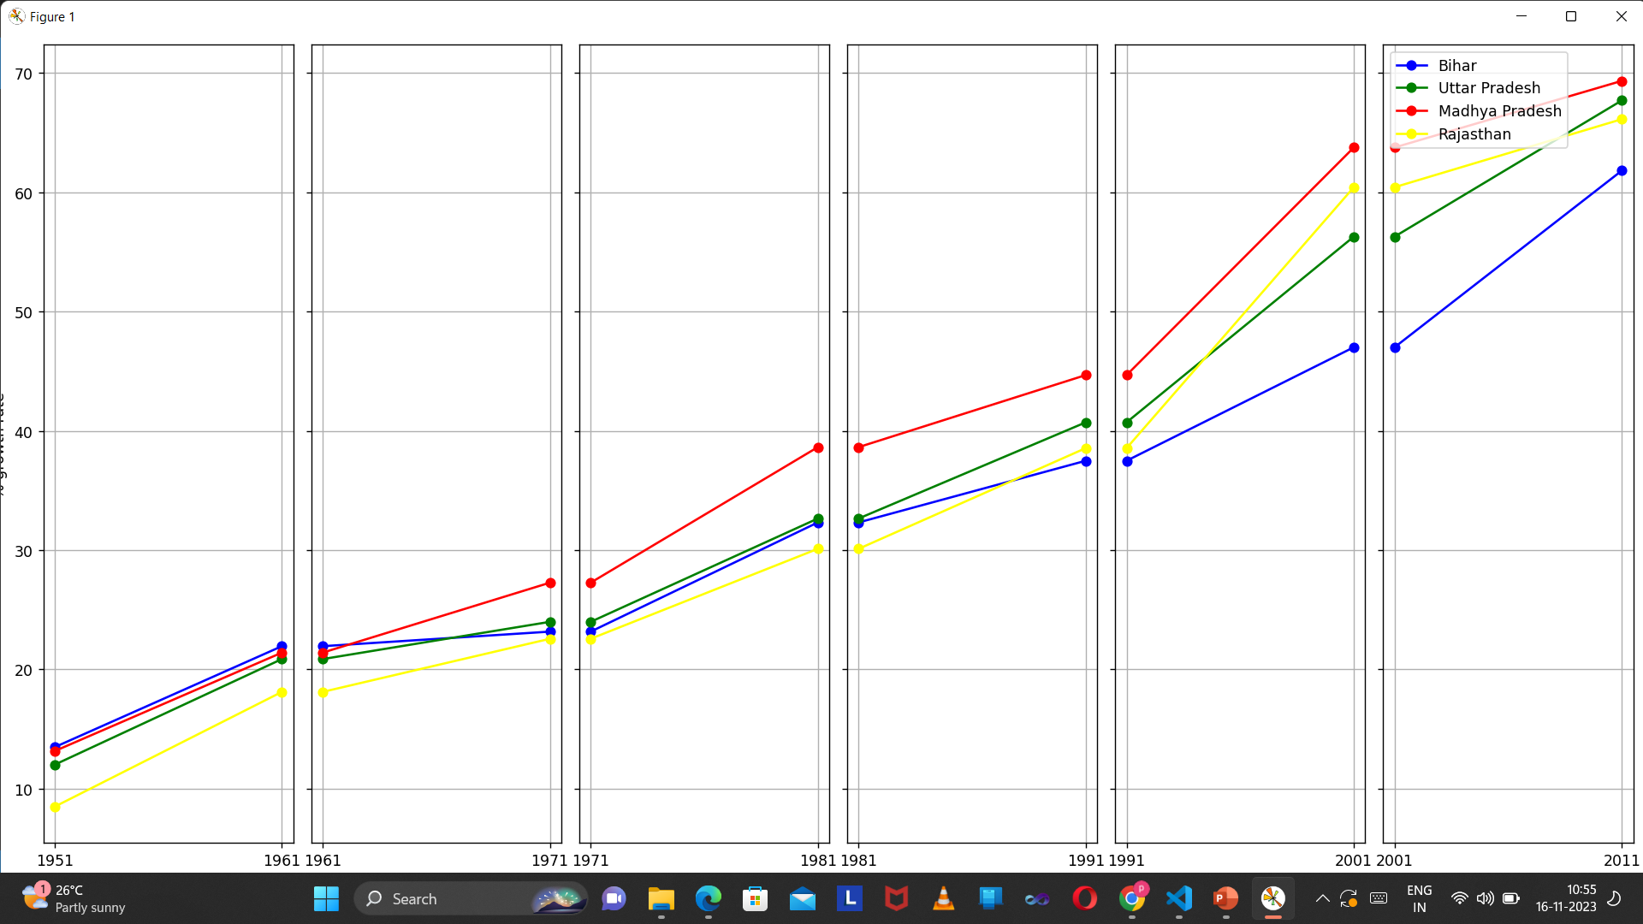
Decadal growth of literacy rate-:

Slide 7
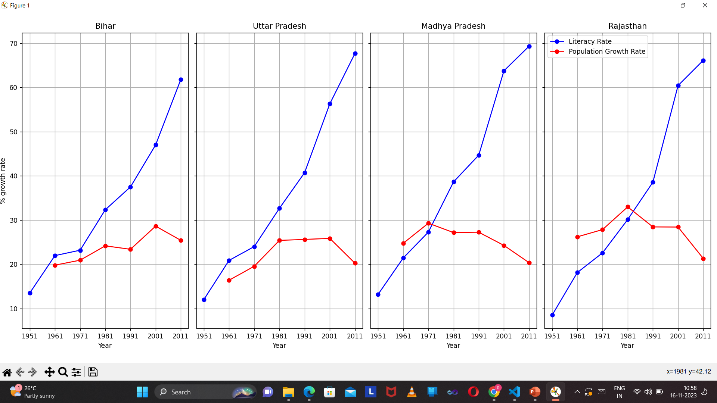
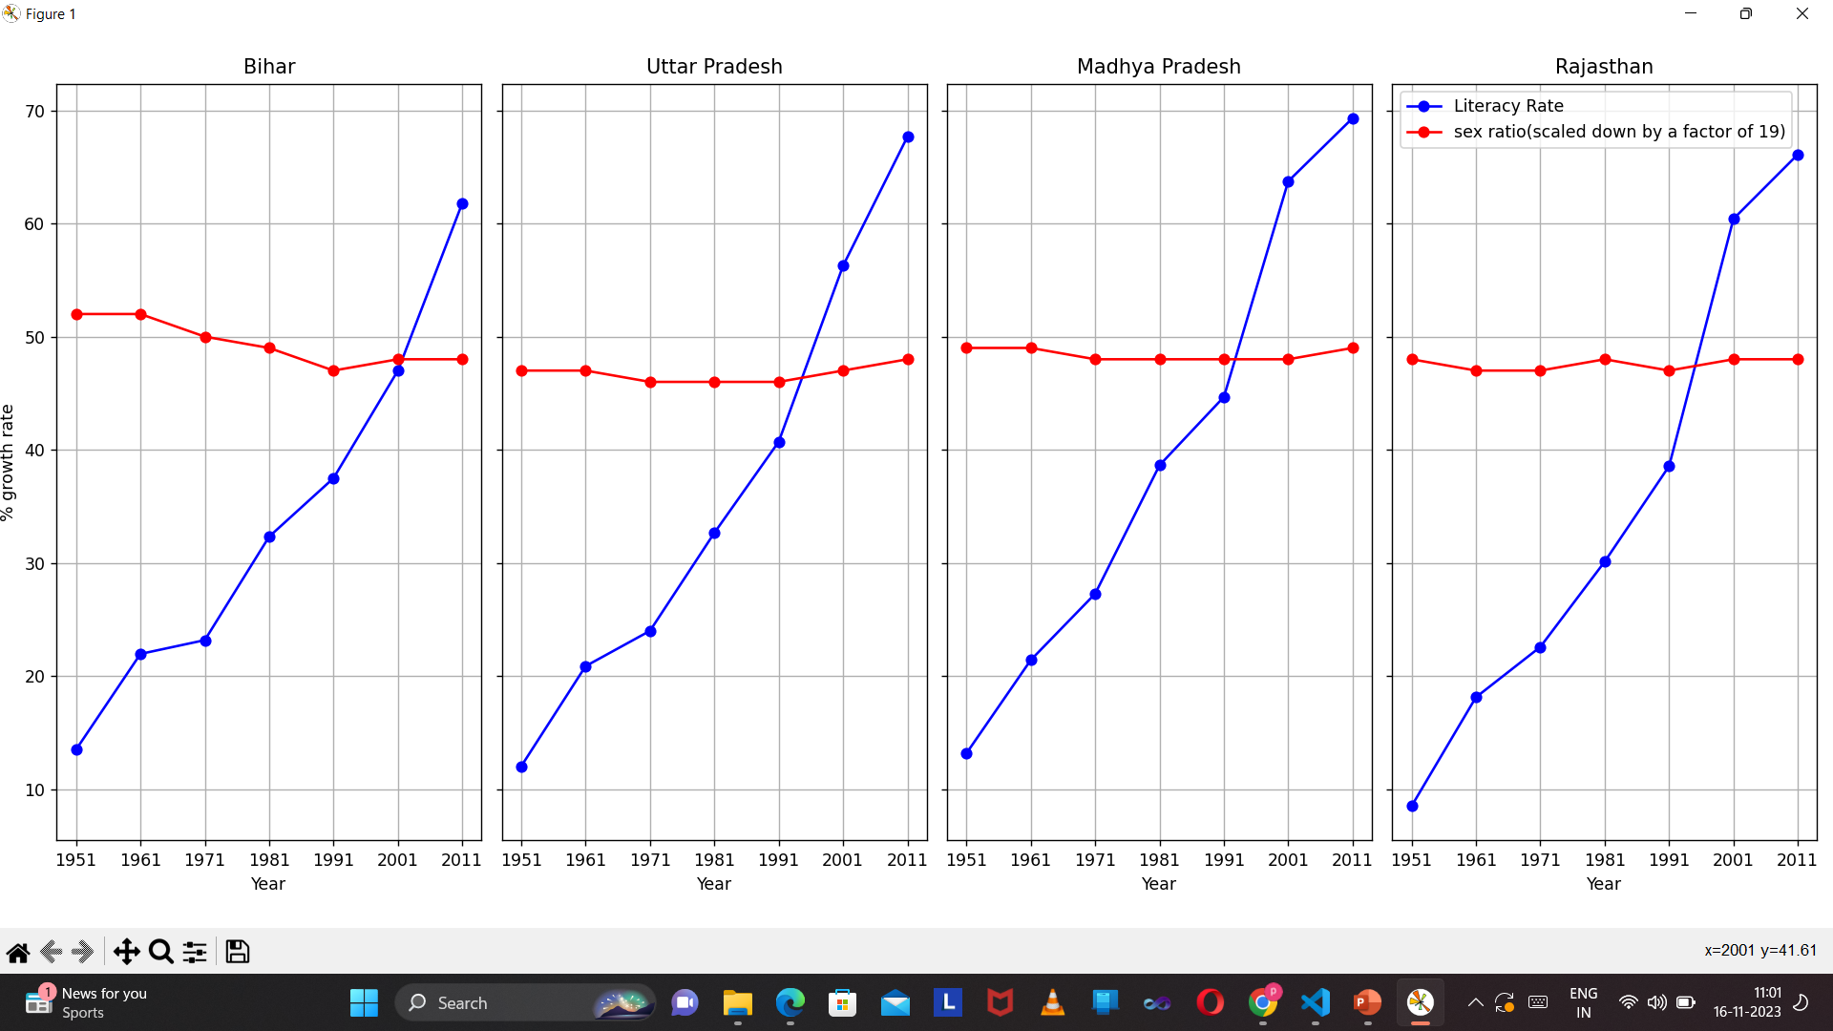
Effect of literacy on population growth and sex ratio-:

Slide 8
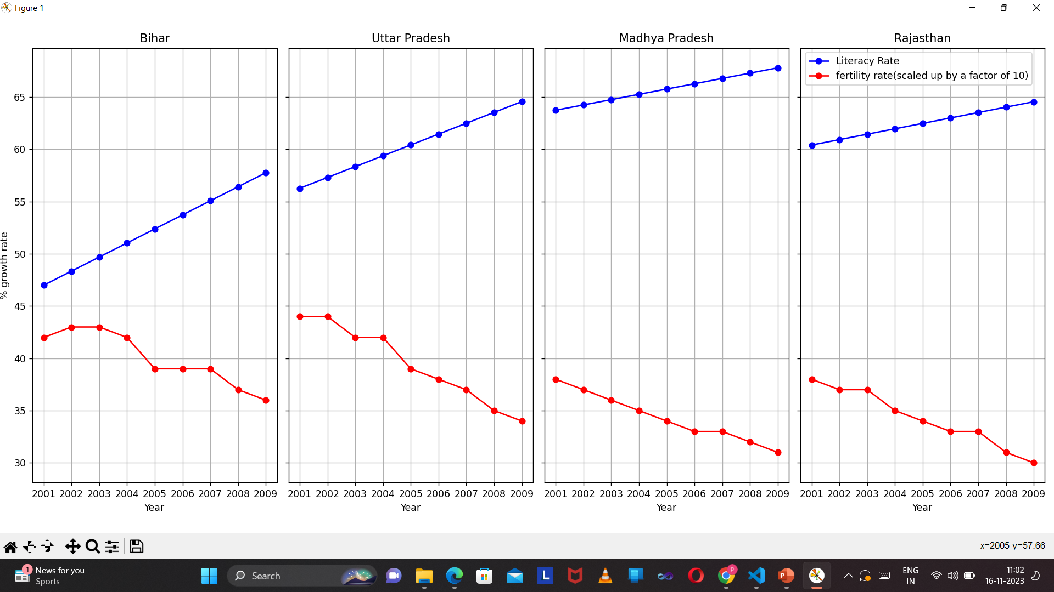
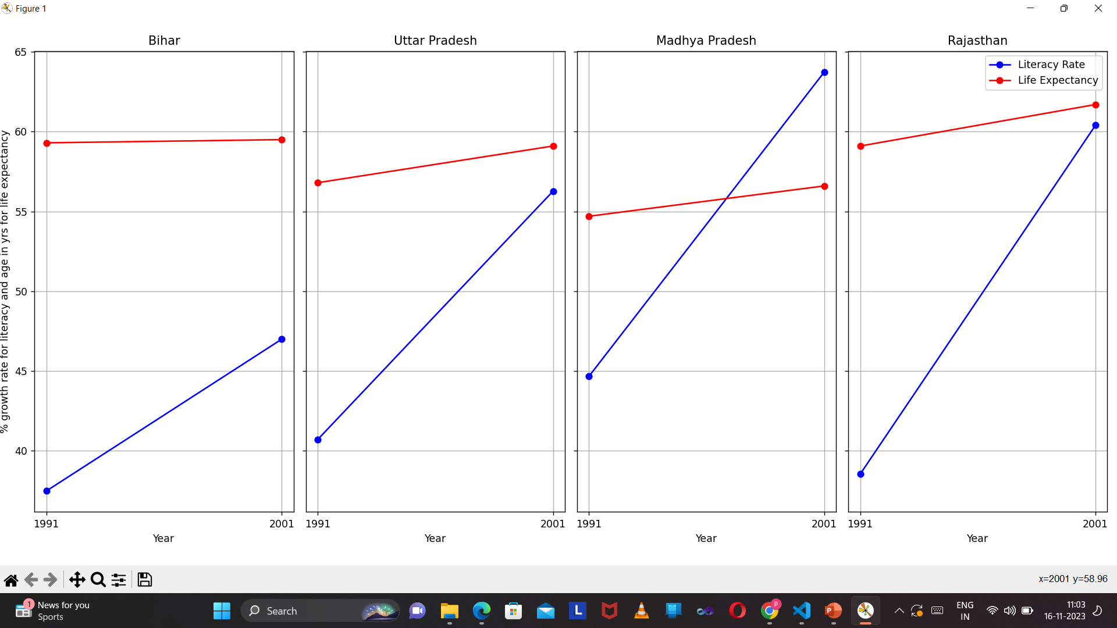
Effect of literacy on fertility rate and life expectancy-:

Slide 9
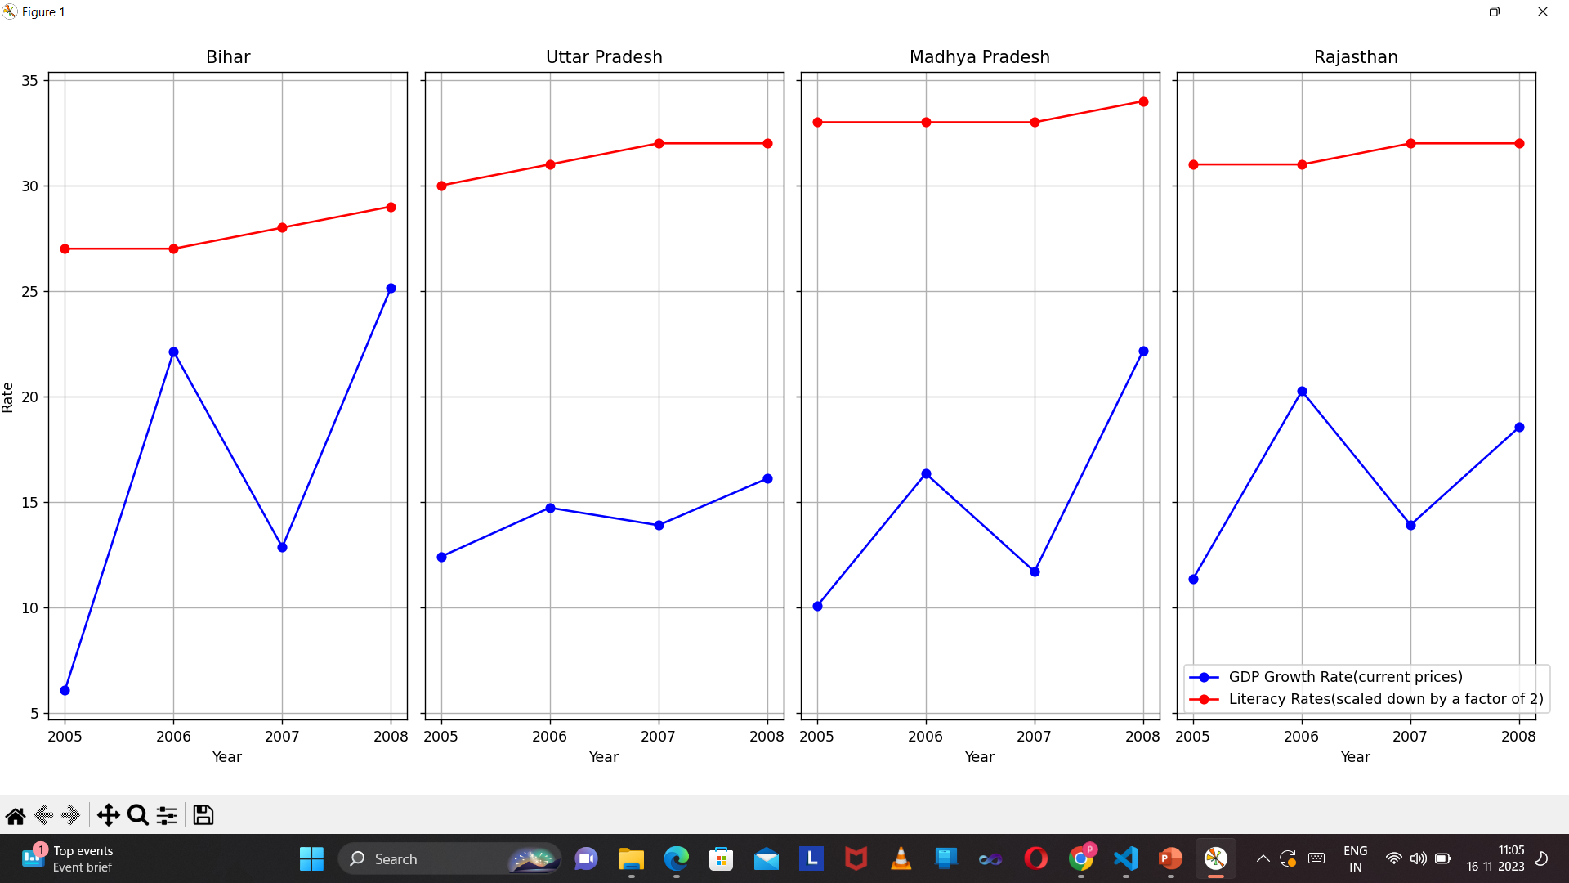
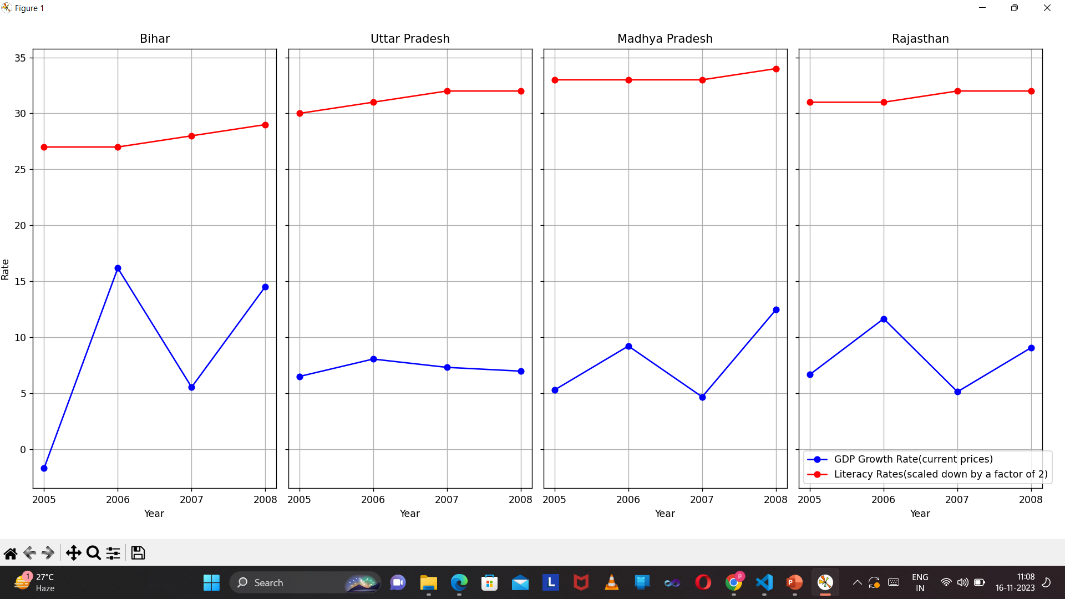
Literacy compared to GDP growth rate-:

Slide 10
Observations -:
Population growth
Sex ratio
Fertility rate
A decline in the growth rate of population wrt and increase in literacy rates across all states could be seen
In all the four states , an increase in literacy rate has had almost no impact on the sex ratio.
An increase in literacy rate has shown a steep decline in fertility rates across all the states.

Slide 11
Observations -:
Life expectancy
GDP Growth rate
A minimal impact on life expectancy can be visualized. No significant impact.
No significant impact on GDP wrt literacy can be found.

Slide 12
summary
In summary we can say that , although Literacy rate did impact some socio-economic parameters like population growth rate and fertility rate , it had almost no impact on issues like sex ratio , life expectancy and GDP growth rate. The reasons could be the effect of other issues like regional politics , health infrastructure or orthodox mindset of the common population.
Although Literacy rate did not impacted all the parameters that I chose , still , I do believe literacy has an important role to play for the overall upliftment of the society. Although gains can not be seen in the short span , it would prove to have a long lasting effect in the long run

Slide 13
thank you
Prakhar Shankar
234161007
MTech Data Science

